Slide 1
Databases
Introduction to SQL
Notes:
1
20483C
1: Review of Visual C# Syntax

Slide 2
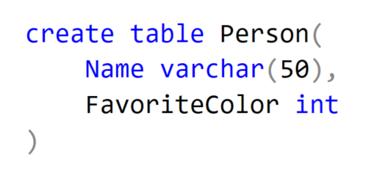
Join
Notes:
Slutresultatet
2
20483C
1: Review of Visual C# Syntax

Slide 3
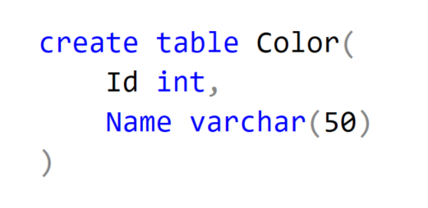
Join
Notes:
Slutresultatet
3
20483C
1: Review of Visual C# Syntax

Slide 4
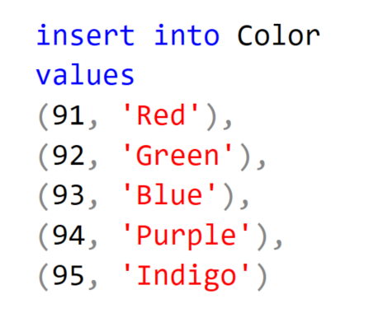
Join
Notes:
Slutresultatet
4
20483C
1: Review of Visual C# Syntax

Slide 5
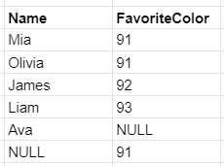
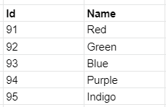
Join
Notes:
Slutresultatet
5
20483C
1: Review of Visual C# Syntax

Slide 6
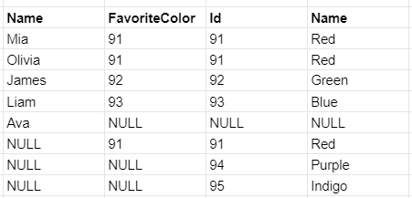
Join
Notes:
Slutresultatet
6
20483C
1: Review of Visual C# Syntax

Slide 7
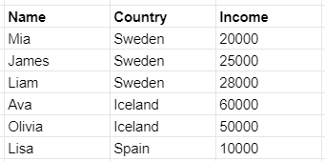
Group By
Notes:
Slutresultatet
7
20483C
1: Review of Visual C# Syntax

Slide 8
Group By
Notes:
Slutresultatet
8
20483C
1: Review of Visual C# Syntax

Slide 9
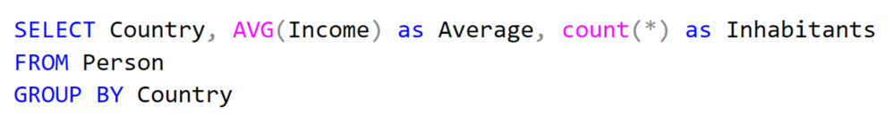
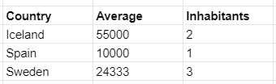
Group By
Notes:
Slutresultatet
9
20483C
1: Review of Visual C# Syntax

Slide 10
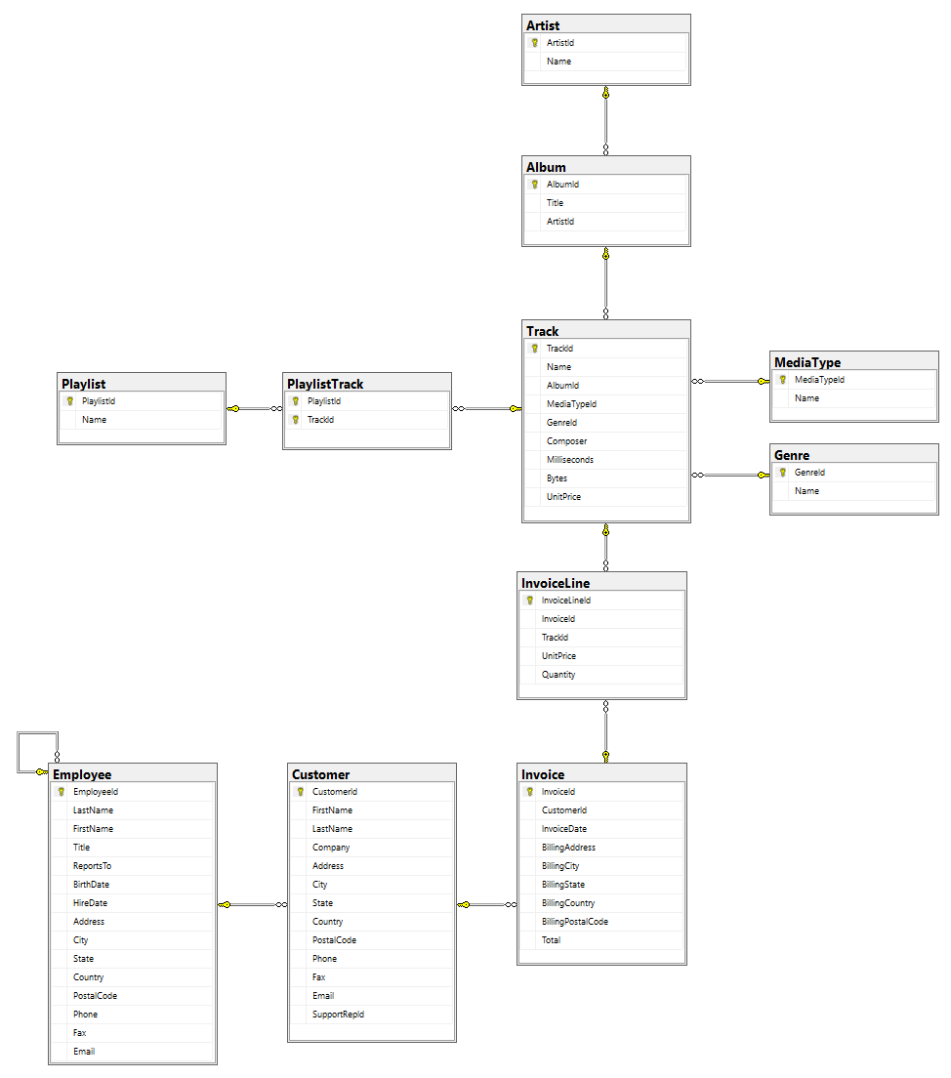
Chinook
Notes:
10
20483C
1: Review of Visual C# Syntax

Slide 11
Reflection
Why databases?
Storing
Consistent
Performance
Many users
Robust
SQL
Standarized
Read, Update, Remove
Create tables
Notes:
11
20483C
1: Review of Visual C# Syntax

Slide 12
Reflection
Join
Combining tables
Keys
Consistent data
Group by
Sum
Average
Notes:
Normalize
Multiple tables (to reduce repetition)
Join
Left, right, full
Group by
Summerize
Report
12
20483C
1: Review of Visual C# Syntax

